Slide 1
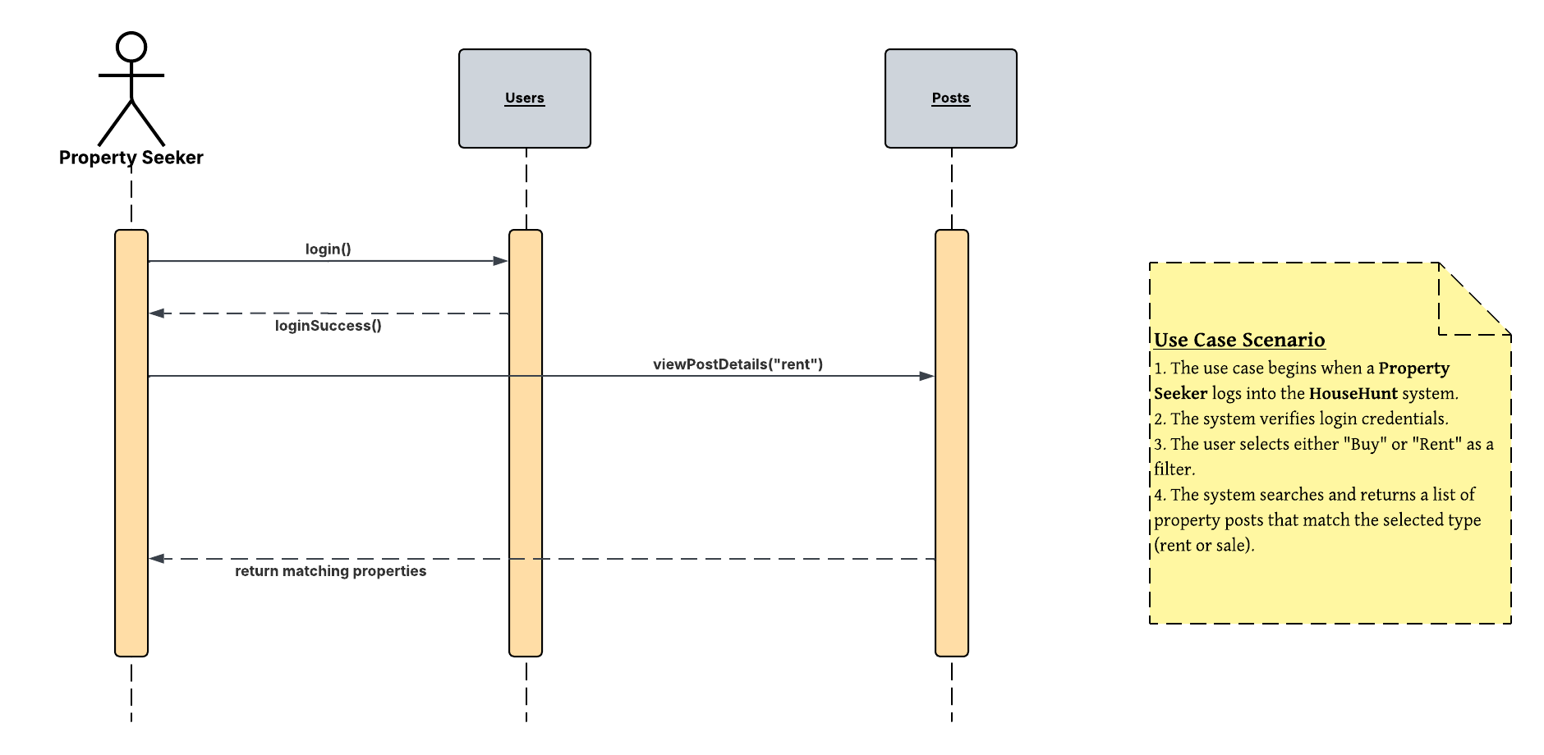
UML Sequence Diagram – House Hunt Use Case – 03.01. Search by Buy/Rent

Slide 2
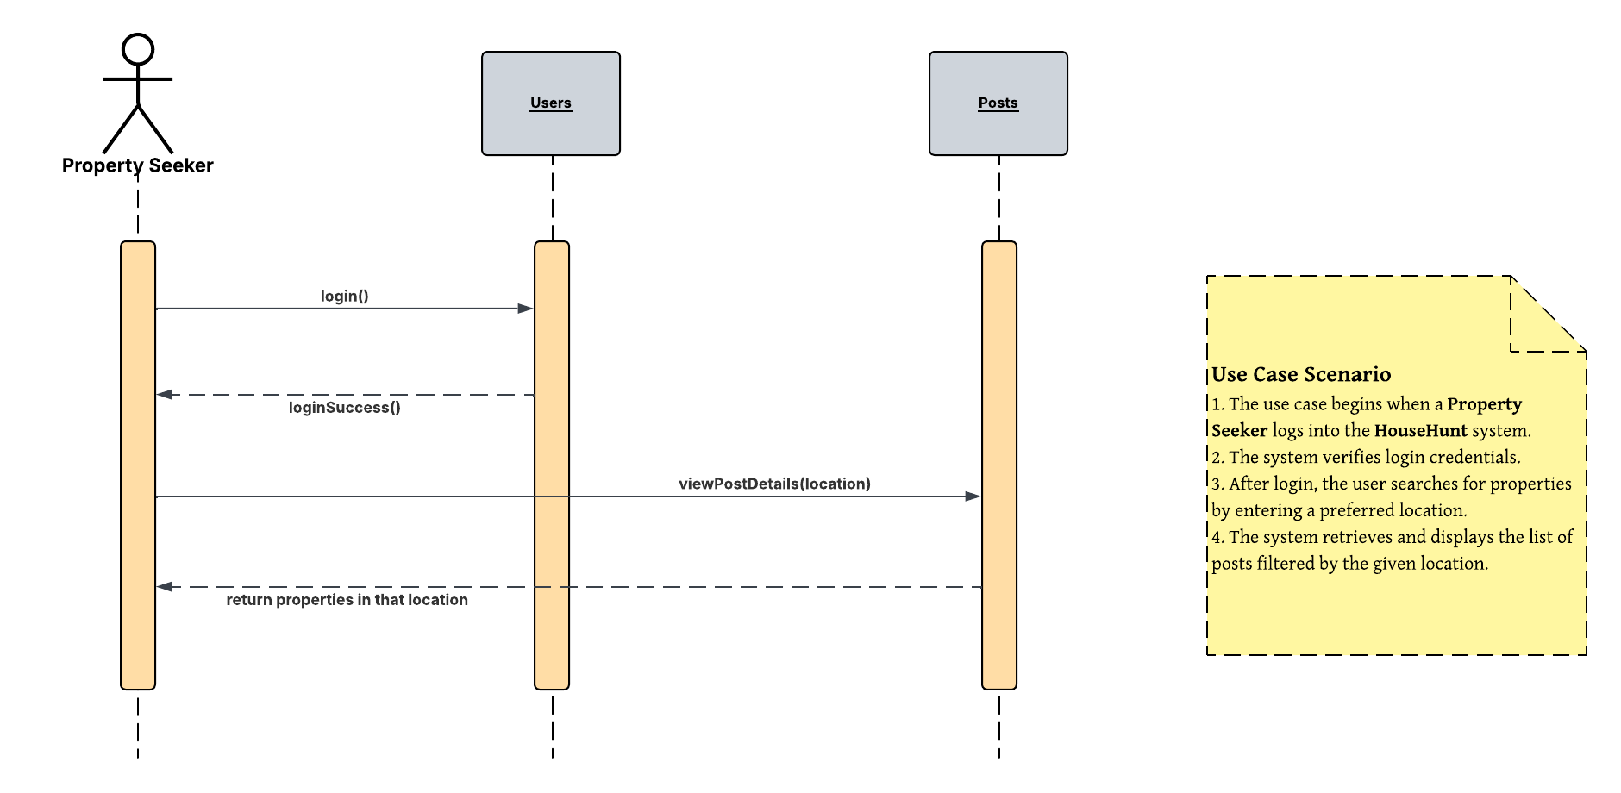
UML Sequence Diagram – House Hunt Use Case – 03.02. Search by Location

Slide 3
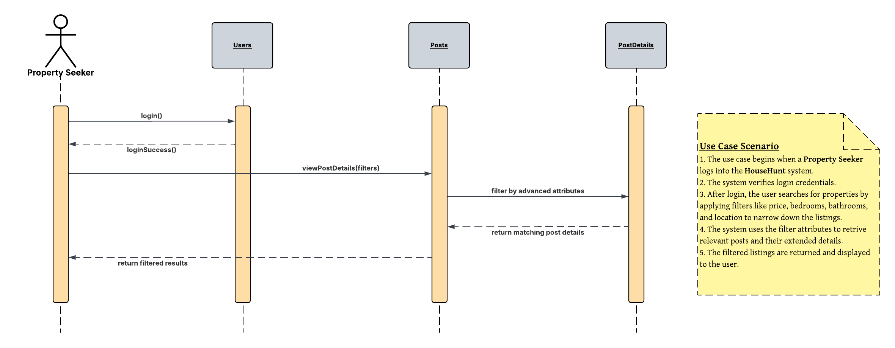
UML Sequence Diagram – House Hunt Use Case – 03.03. Search by Advanced Filters

Slide 4
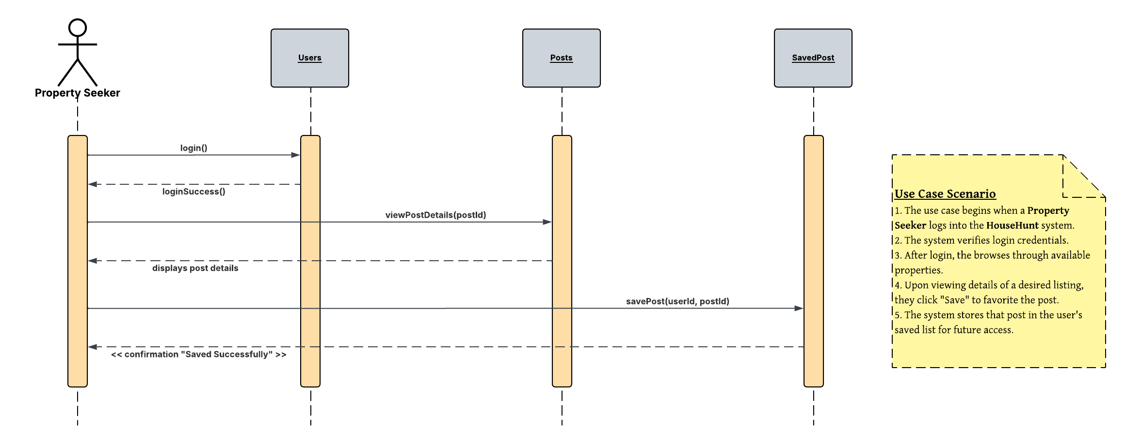
UML Sequence Diagram – House Hunt Use Case – 03.04. Save Favorite Properties

Slide 5
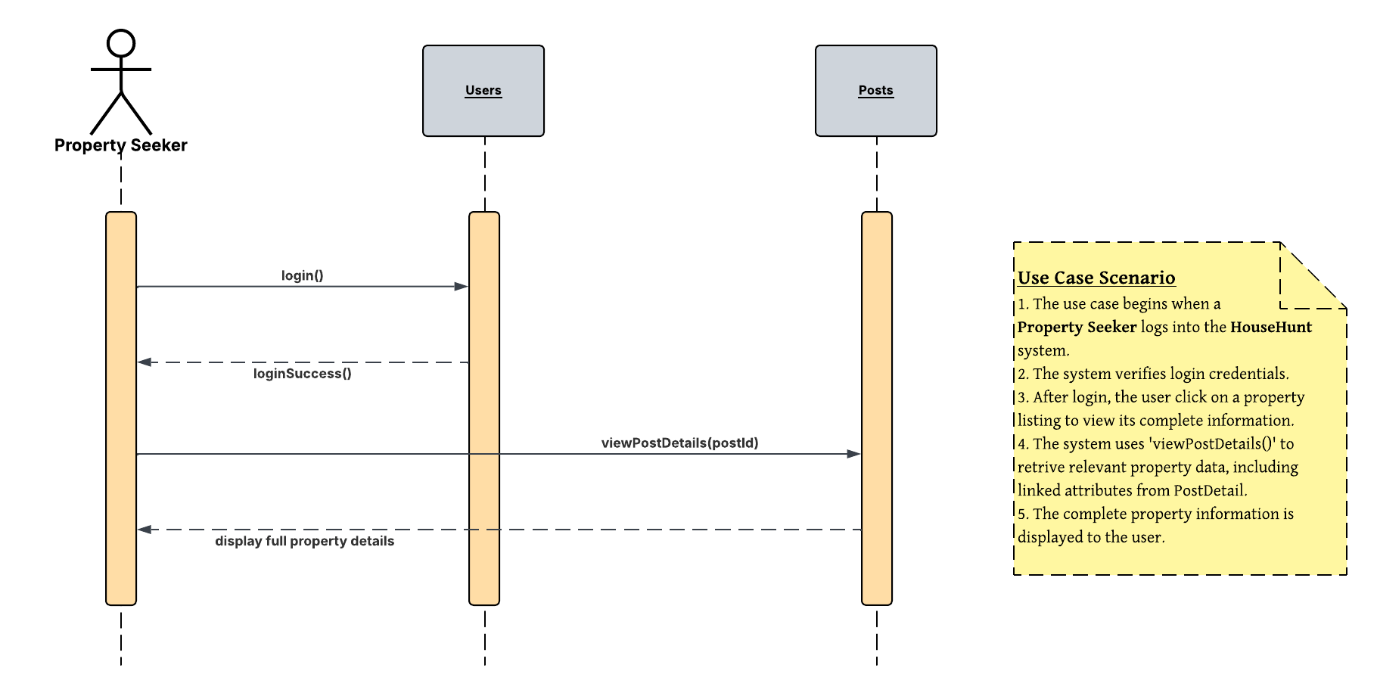
UML Sequence Diagram – House Hunt Use Case – 03.05. View Property Information

